Slide 1
Encoding

Slide 2
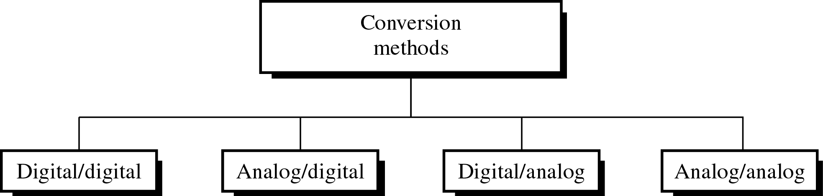
Figure 5-1
Different Conversion Schemes

Slide 3
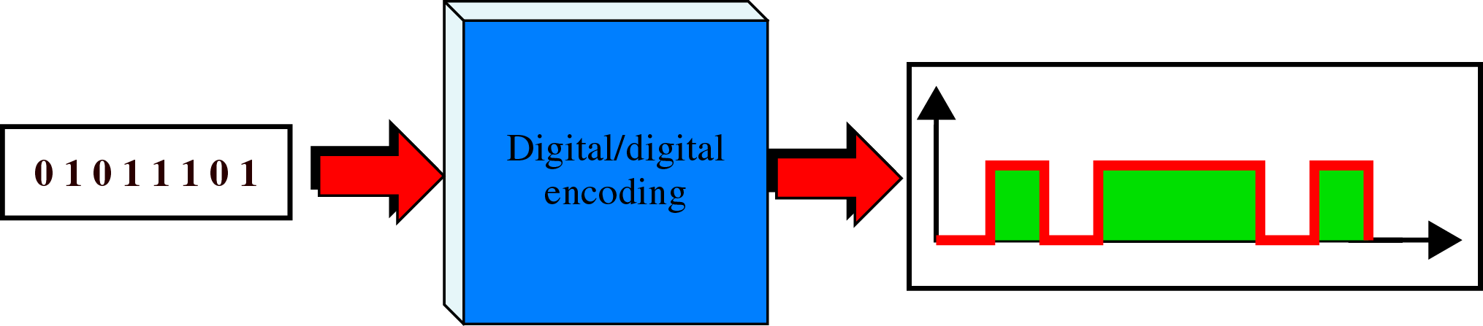
Figure 5-2
Digital to Digital Encoding

Slide 4
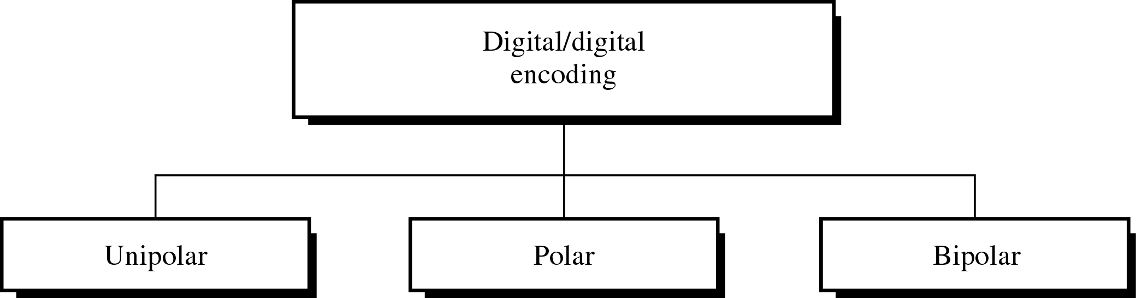
Figure 5-3
Types of Digital to Digital Encoding

Slide 5
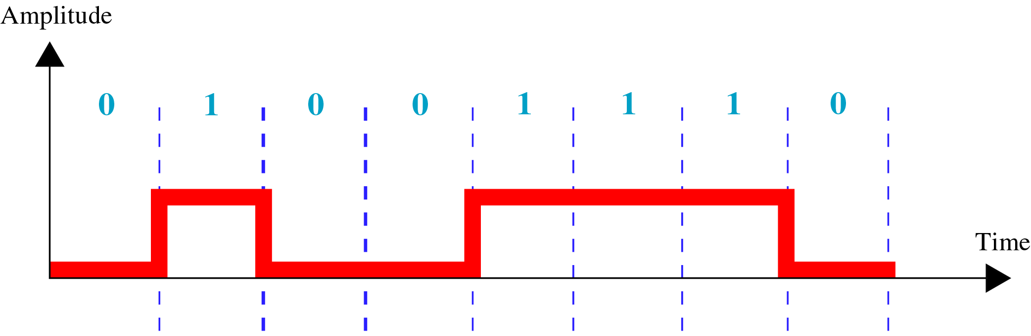
Figure 5-4
Unipolar Encoding

Slide 6
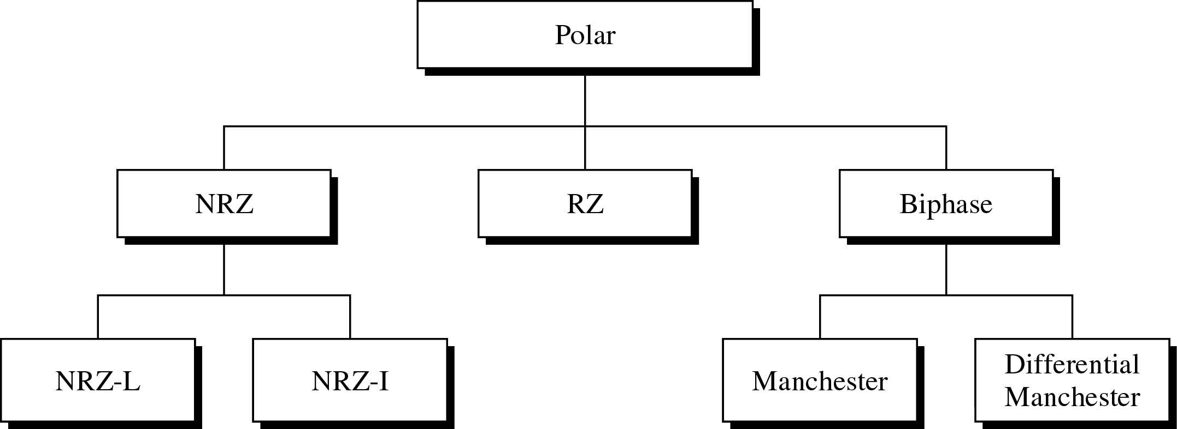
Figure 5-5
Types of Polar Encoding

Slide 7
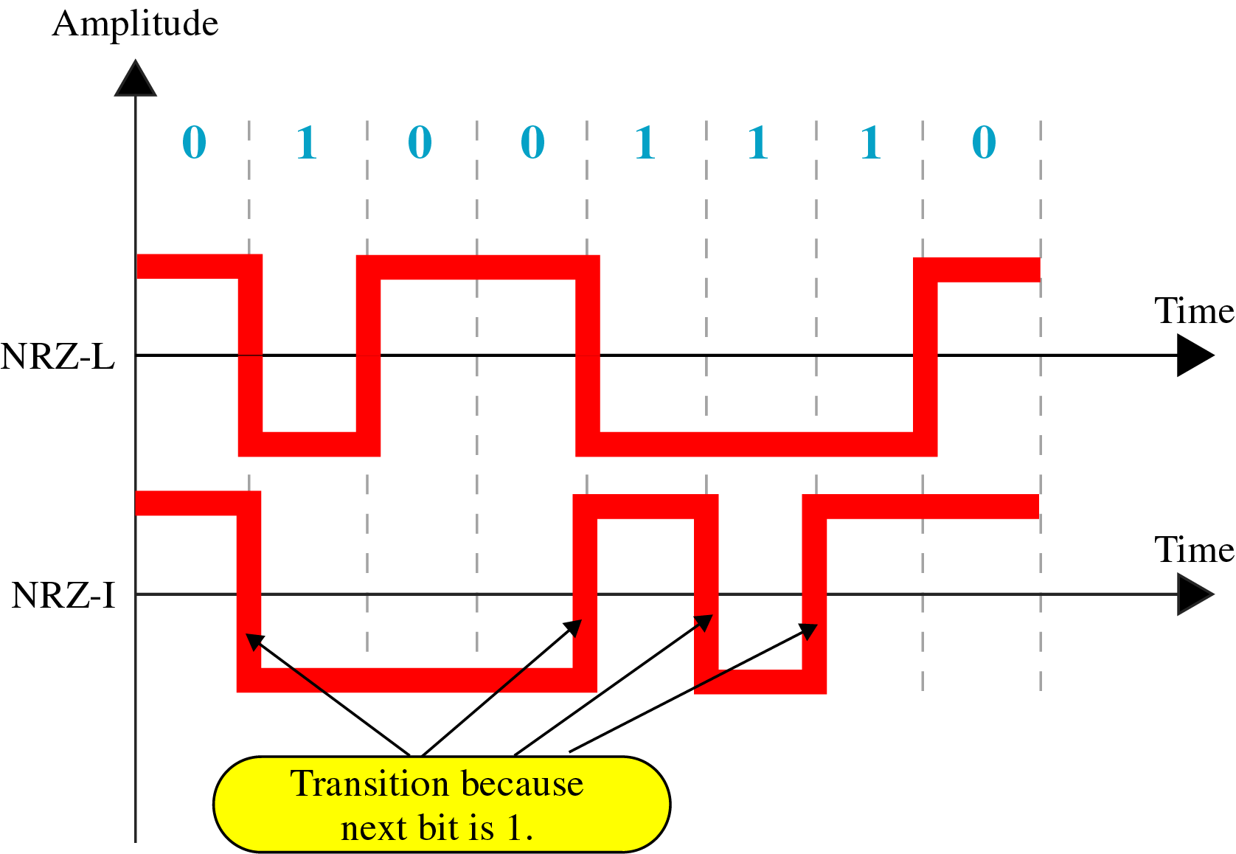
Figure 5-6
NRZ-L and NRZ-I Encoding

Slide 8
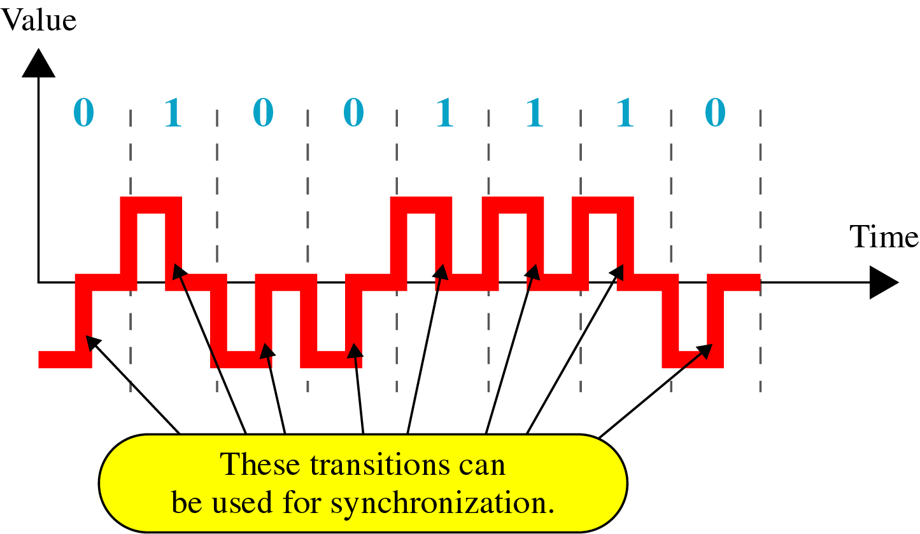
Figure 5-7
RZ Encoding

Slide 9
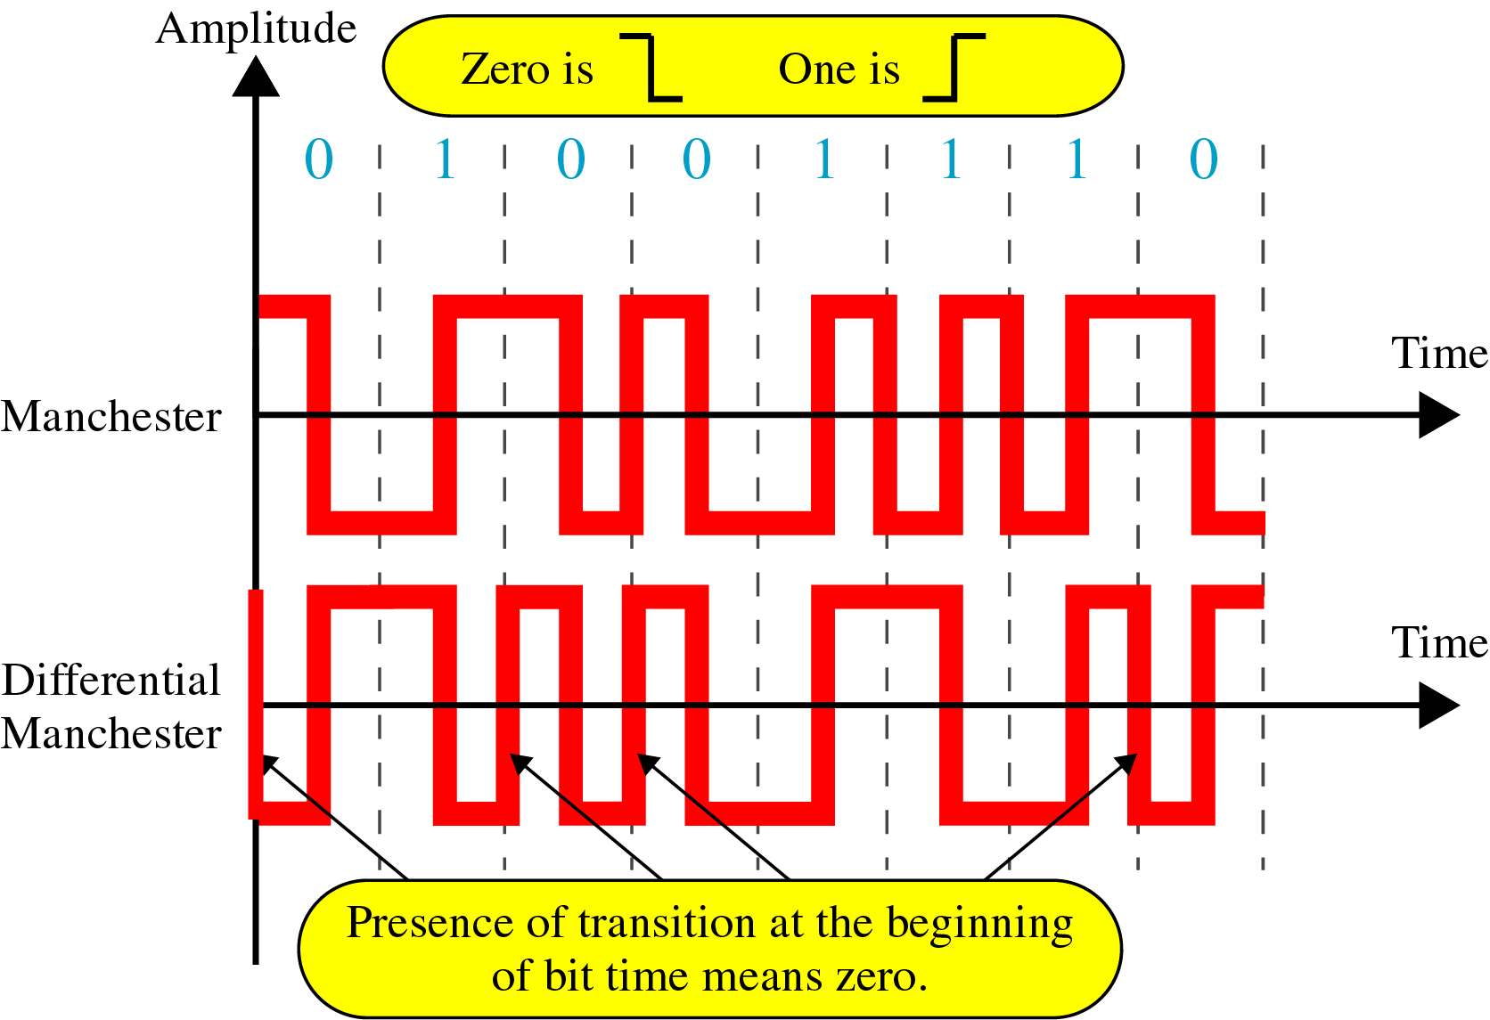
Figure 5-8
Manchester and Diff. Manchester Encoding

Slide 10
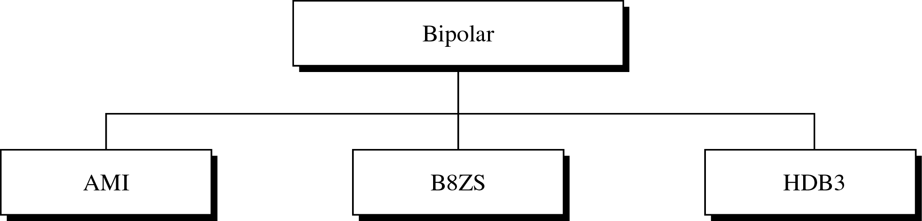
Figure 5-9
Types of Bipolar Encoding

Slide 11
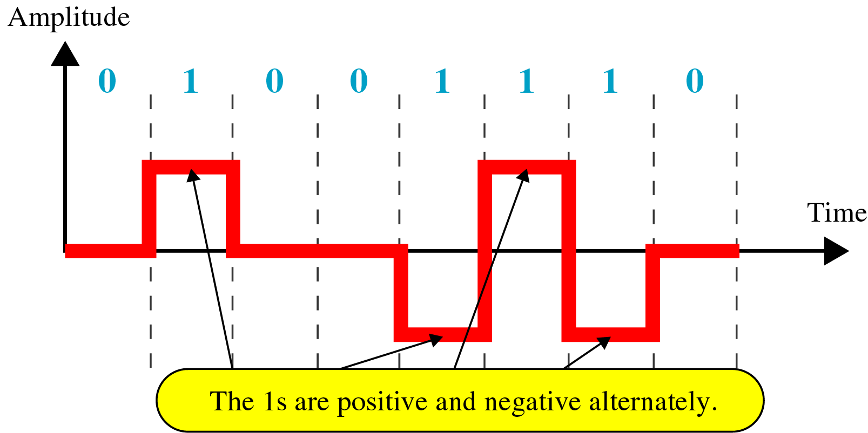
Figure 5-10
Bipolar AMI Encoding

Slide 12
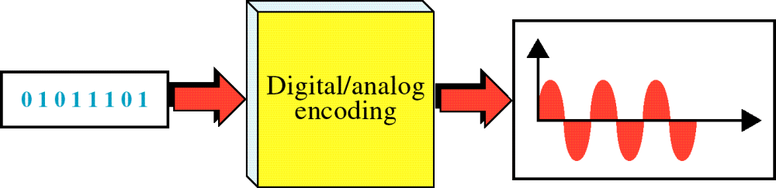
Figure 5-22
Digital to Analog Encoding
WCB/McGraw-Hill
© The McGraw-Hill Companies, Inc., 1998

Slide 13
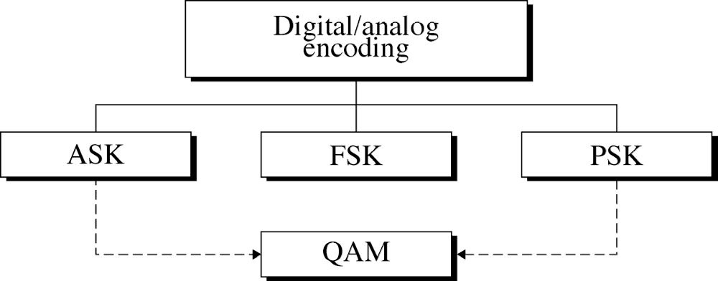
Figure 5-23
WCB/McGraw-Hill
© The McGraw-Hill Companies, Inc., 1998

Slide 14
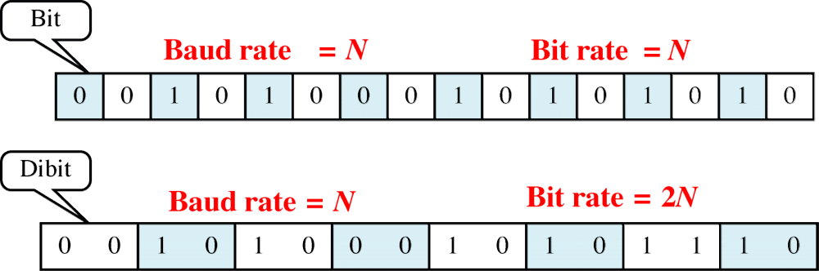
Figure 5-38
Bit Rate and Baud Rate
WCB/McGraw-Hill
© The McGraw-Hill Companies, Inc., 1998

Slide 15
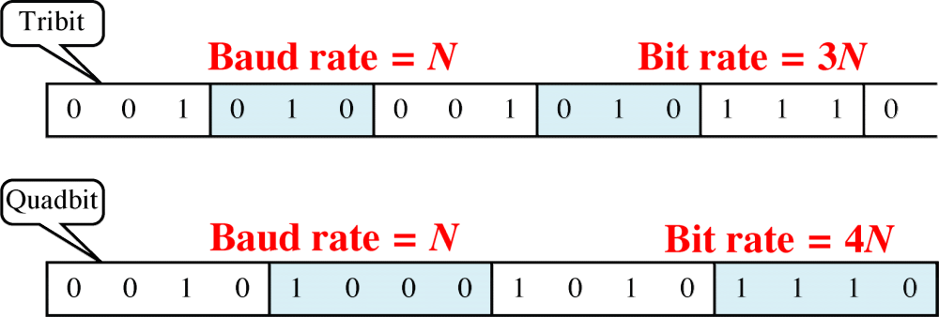
Figure 5-38-continued
Bit Rate and Baud Rate
WCB/McGraw-Hill
© The McGraw-Hill Companies, Inc., 1998

Slide 16
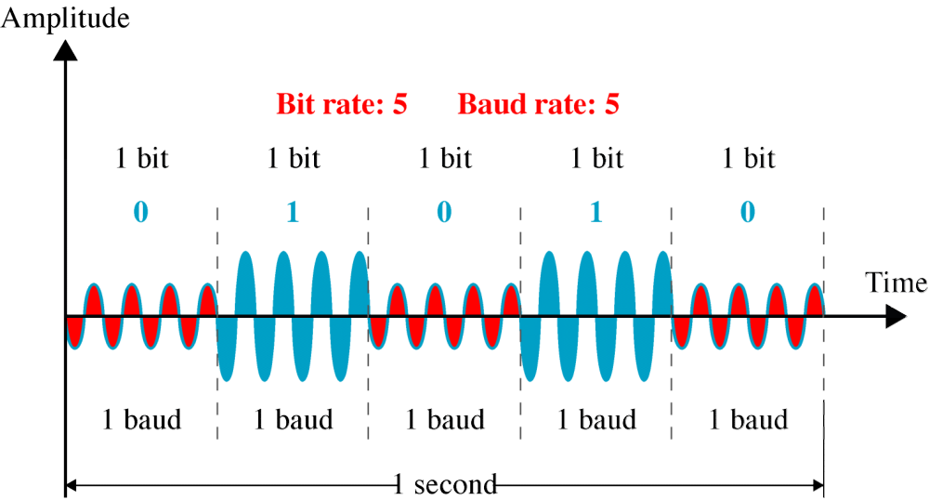
Figure 5-24
ASK
WCB/McGraw-Hill
© The McGraw-Hill Companies, Inc., 1998

Slide 17
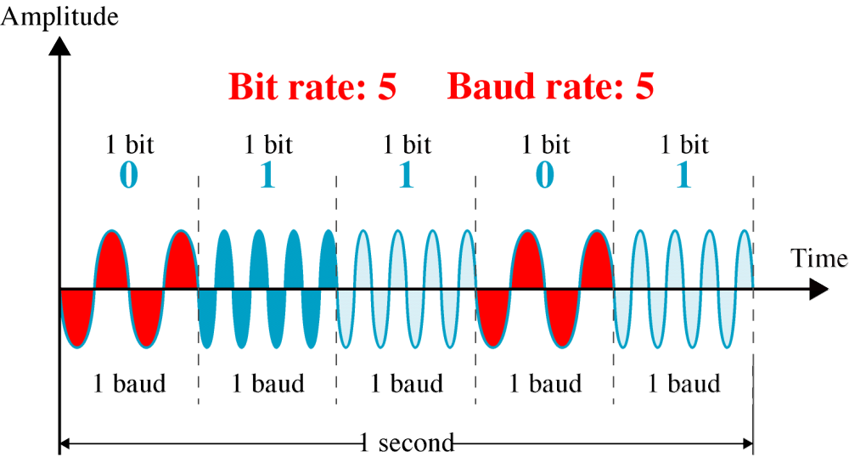
Figure 5-27
FSK
WCB/McGraw-Hill
© The McGraw-Hill Companies, Inc., 1998

Slide 18
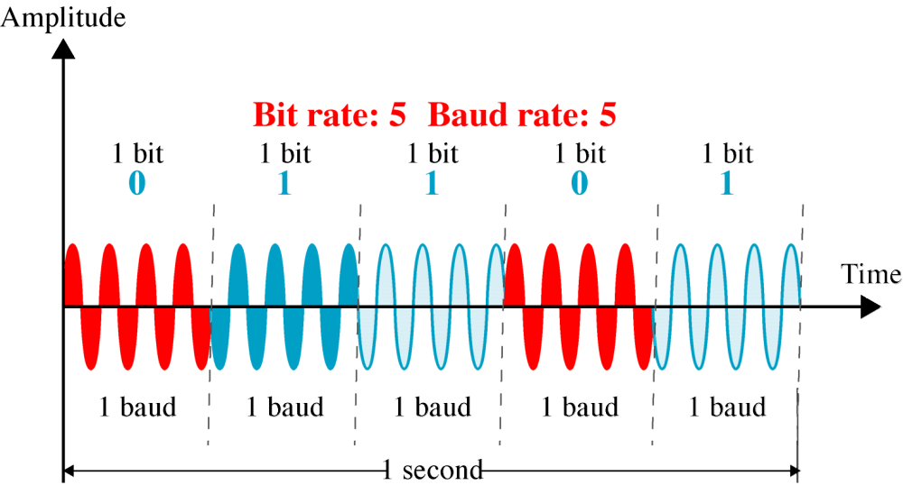
Figure 5-29
PSK
WCB/McGraw-Hill
© The McGraw-Hill Companies, Inc., 1998

Slide 19
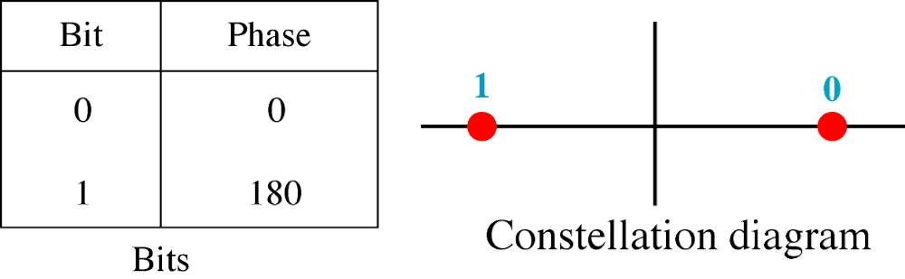
Figure 5-30
PSK
Constellation
WCB/McGraw-Hill
© The McGraw-Hill Companies, Inc., 1998

Slide 20
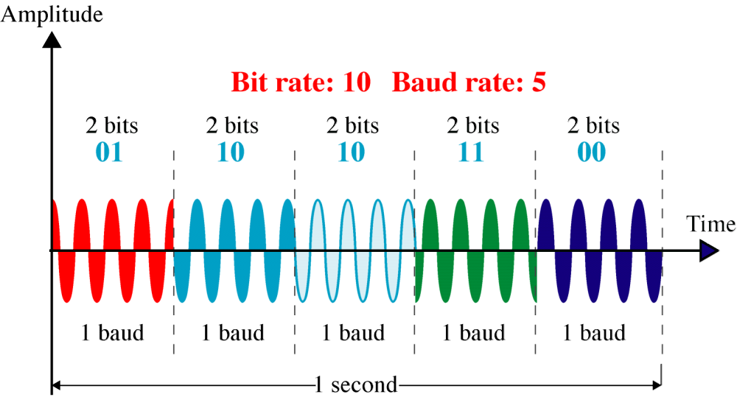
Figure 5-31
4-PSK
WCB/McGraw-Hill
© The McGraw-Hill Companies, Inc., 1998

Slide 21
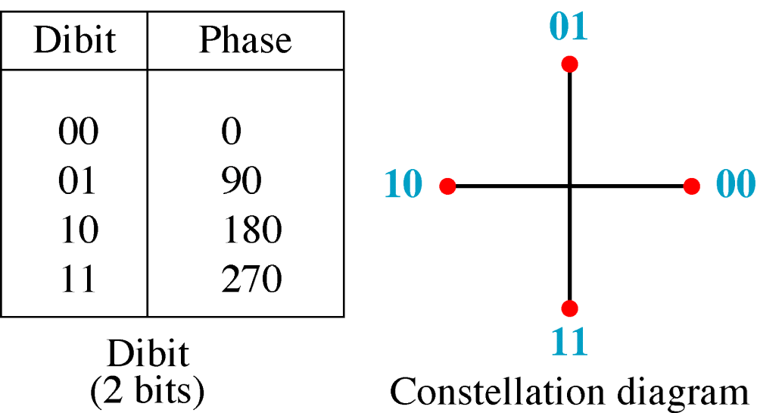
Figure 5-32
4-PSK
Characteristics
WCB/McGraw-Hill
© The McGraw-Hill Companies, Inc., 1998

Slide 22
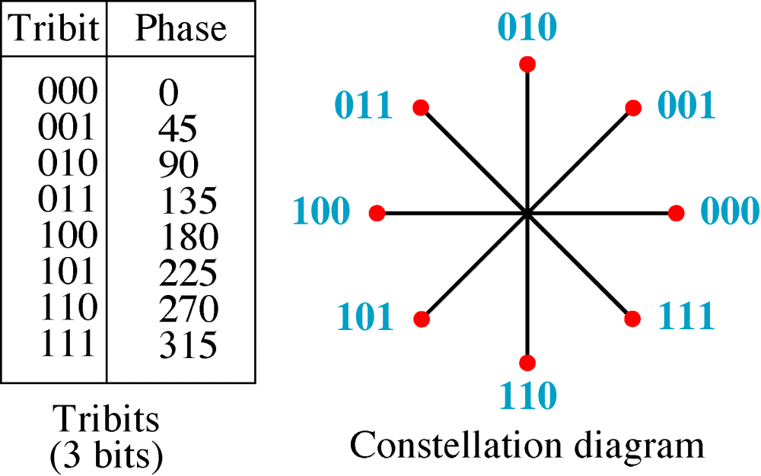
Figure 5-33
8-PSK
Characteristics
WCB/McGraw-Hill
© The McGraw-Hill Companies, Inc., 1998

Slide 23
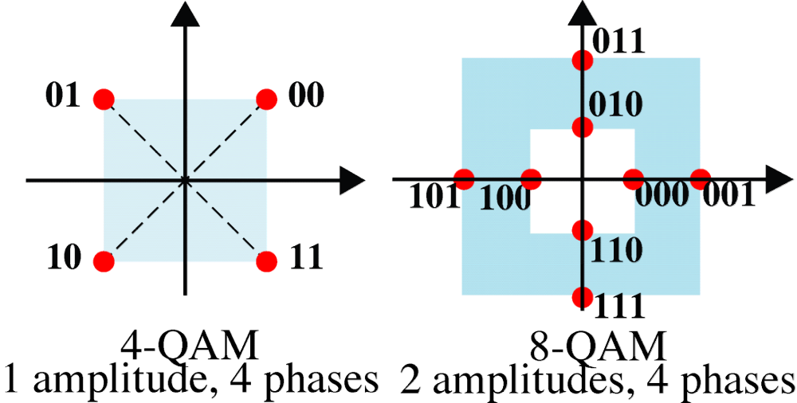
Figure 5-35
4-QAM and 8-QAM
Constellations
WCB/McGraw-Hill
© The McGraw-Hill Companies, Inc., 1998

Slide 24
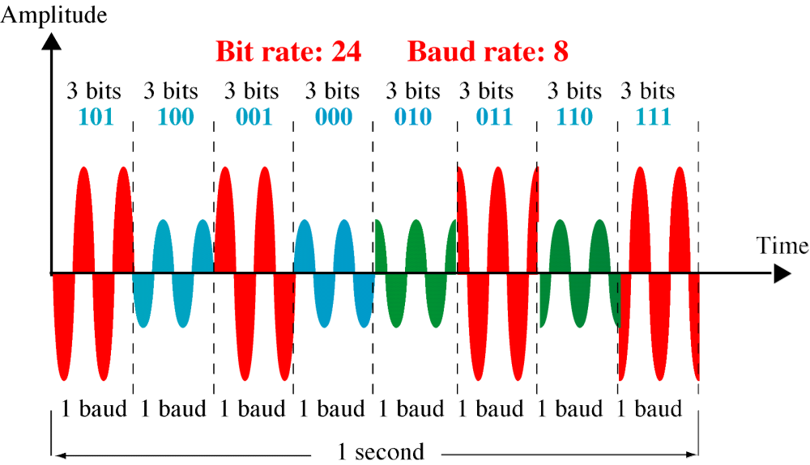
Figure 5-36
8-QAM Signal
WCB/McGraw-Hill
© The McGraw-Hill Companies, Inc., 1998

Slide 25
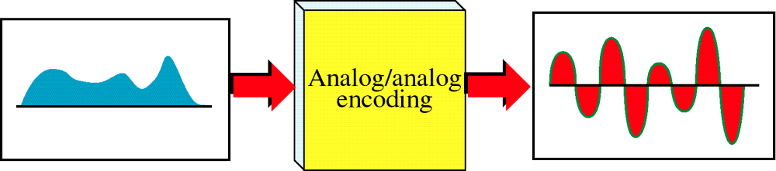
Figure 5-39
Analog to Analog Modulation
WCB/McGraw-Hill
© The McGraw-Hill Companies, Inc., 1998

Slide 26
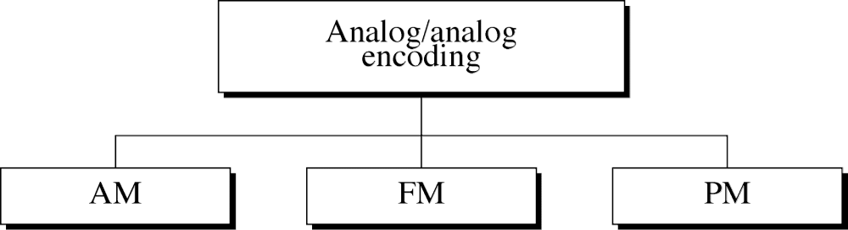
Figure 5-40
WCB/McGraw-Hill
© The McGraw-Hill Companies, Inc., 1998

Slide 27
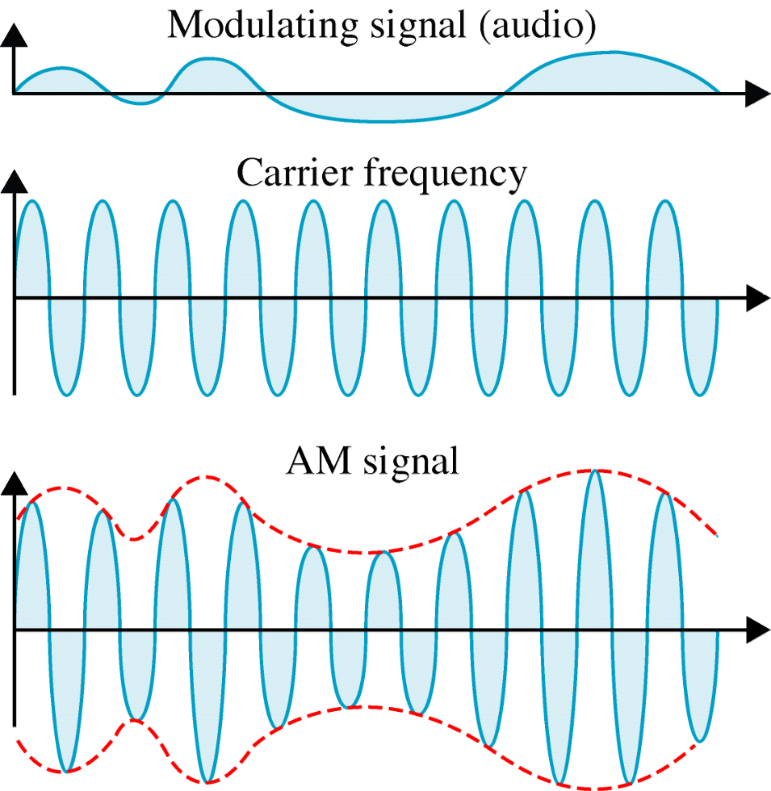
Figure 5-41
Amplitude Modulation
WCB/McGraw-Hill
© The McGraw-Hill Companies, Inc., 1998

Slide 28
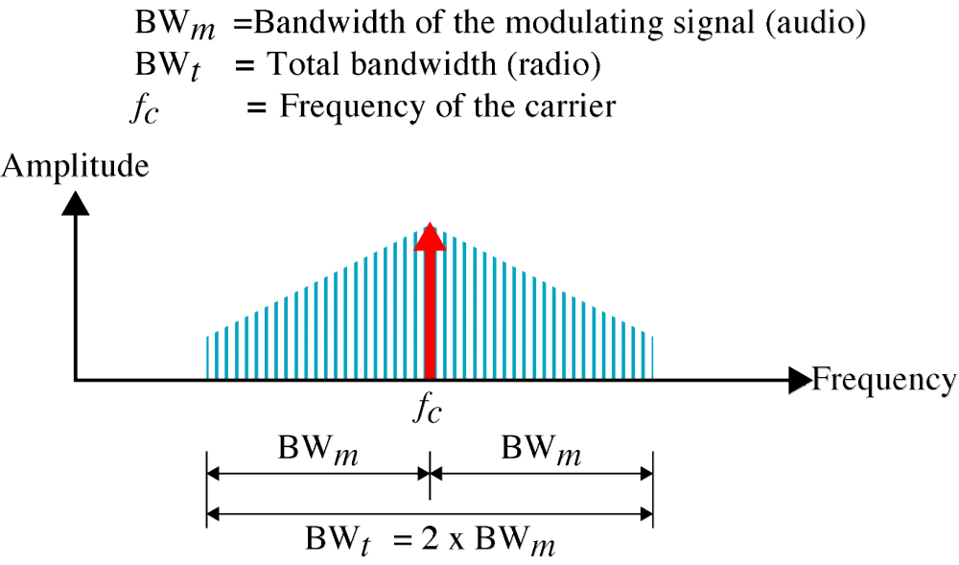
Figure 5-42
AM Bandwidth
WCB/McGraw-Hill
© The McGraw-Hill Companies, Inc., 1998

Slide 29
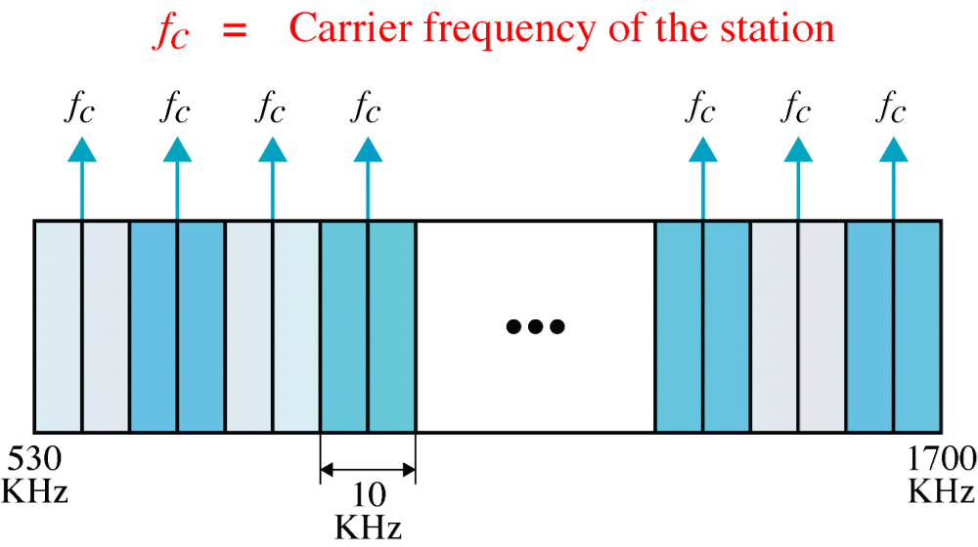
Figure 5-43
AM Band Allocation
WCB/McGraw-Hill
© The McGraw-Hill Companies, Inc., 1998

Slide 30
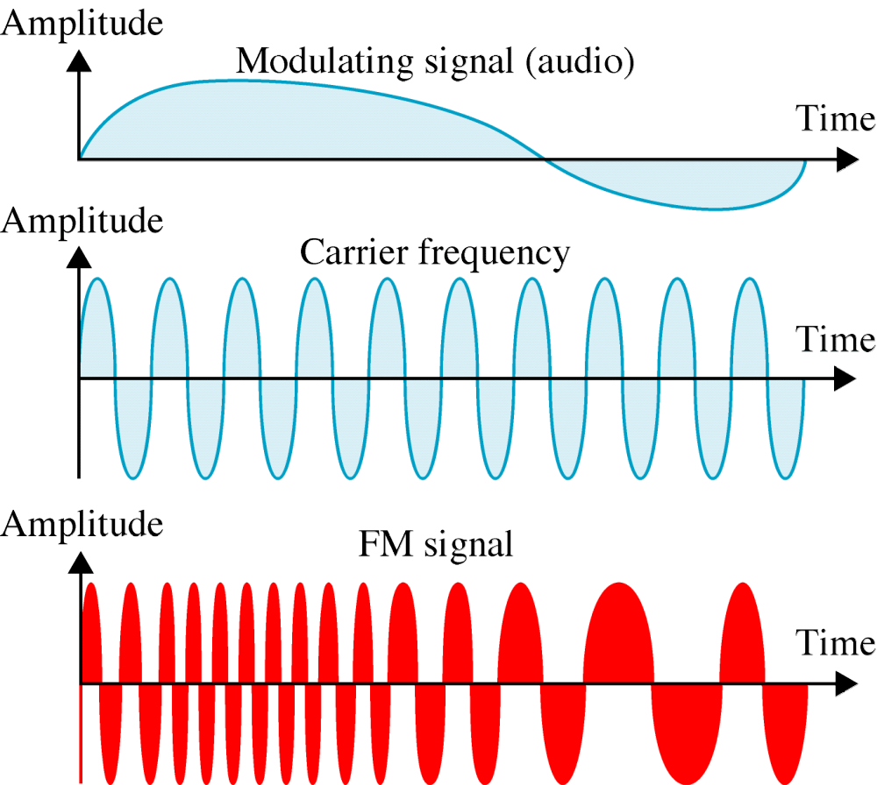
Figure 5-44
Frequency Modulation
WCB/McGraw-Hill
© The McGraw-Hill Companies, Inc., 1998

Slide 31
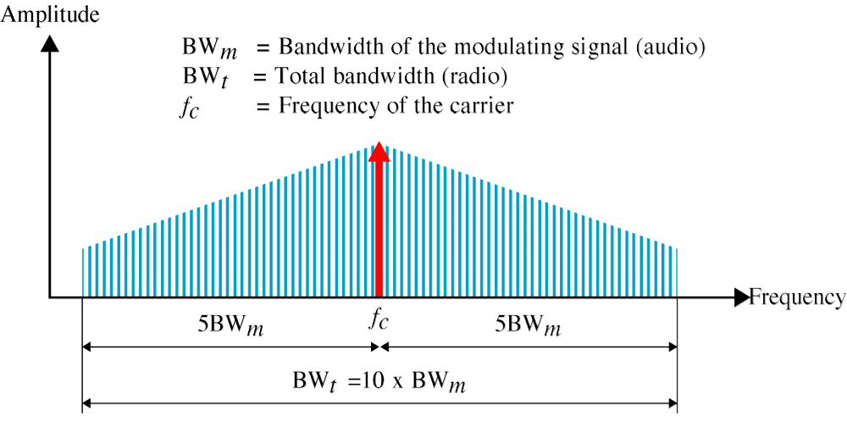
Figure 5-45
FM Bandwidth
WCB/McGraw-Hill
© The McGraw-Hill Companies, Inc., 1998

Slide 32
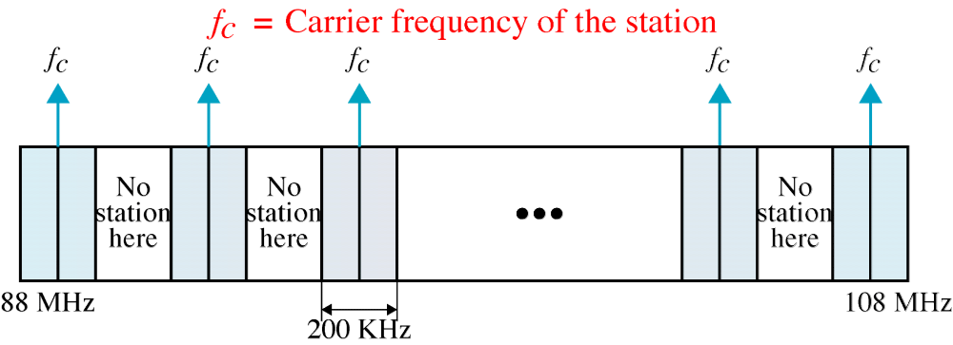
Figure 5-46
FM Band Allocation
WCB/McGraw-Hill
© The McGraw-Hill Companies, Inc., 1998

Slide 33
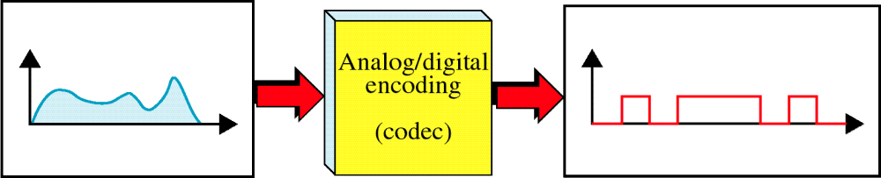
Figure 5-15
Analog to Digital Encoding
WCB/McGraw-Hill
© The McGraw-Hill Companies, Inc., 1998

Slide 34
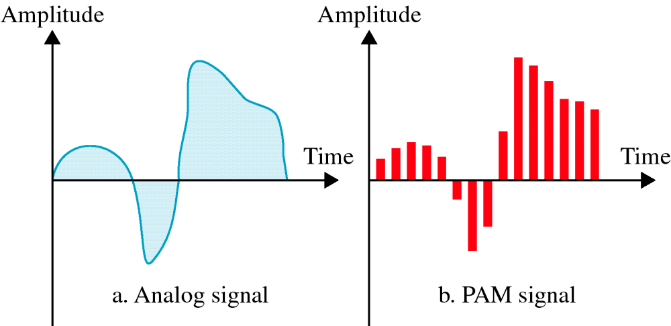
Figure 5-16
PAM
WCB/McGraw-Hill
© The McGraw-Hill Companies, Inc., 1998

Slide 35
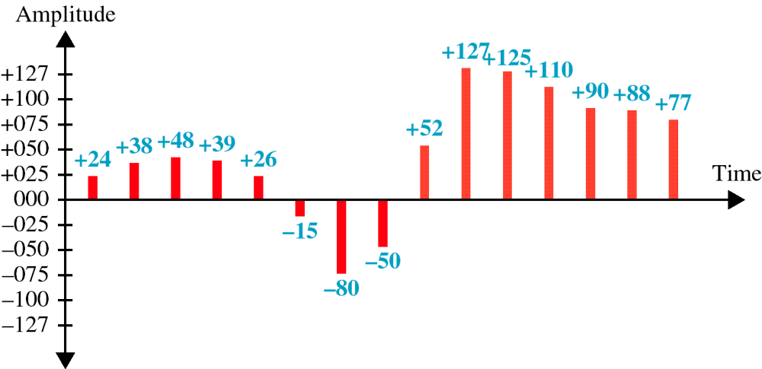
Figure 5-17
Quantized PAM Signal
WCB/McGraw-Hill
© The McGraw-Hill Companies, Inc., 1998

Slide 36
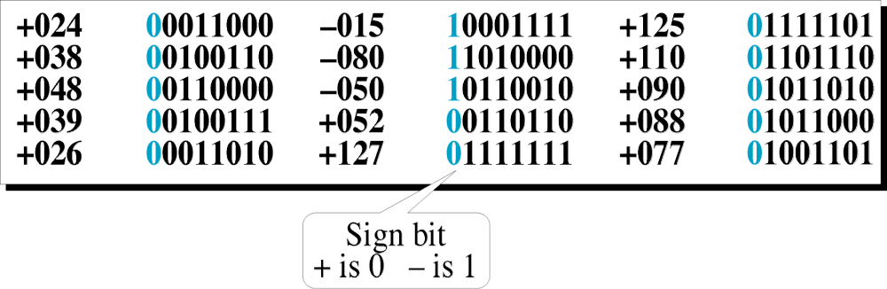
Figure 5-18
Quantizing Using
Sign and Magnitude
WCB/McGraw-Hill
© The McGraw-Hill Companies, Inc., 1998

Slide 37
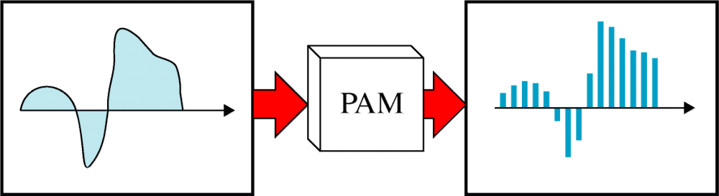
Figure 5-20
From Analog to PCM
WCB/McGraw-Hill
© The McGraw-Hill Companies, Inc., 1998

Slide 38
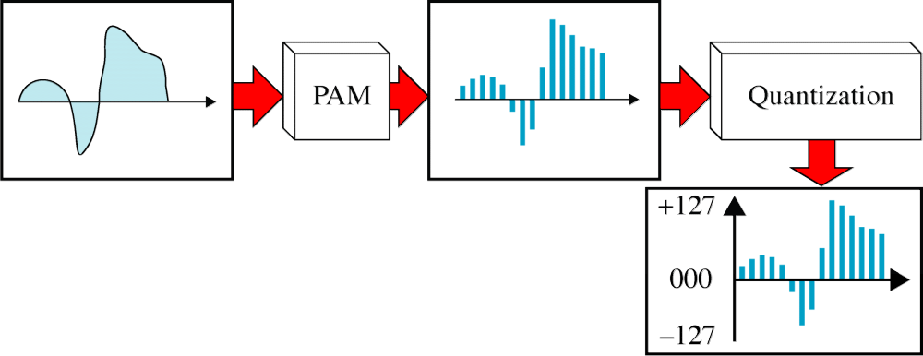
Figure 5-20-continued
From Analog to PCM
WCB/McGraw-Hill
© The McGraw-Hill Companies, Inc., 1998

Slide 39
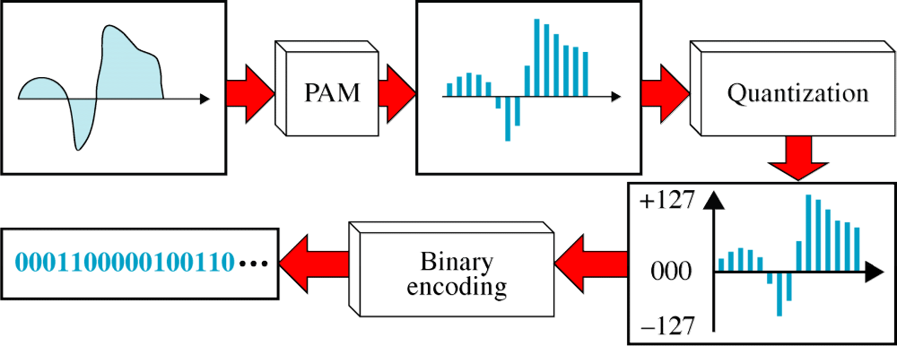
Figure 5-20-continued
From Analog to PCM
WCB/McGraw-Hill
© The McGraw-Hill Companies, Inc., 1998

Slide 40
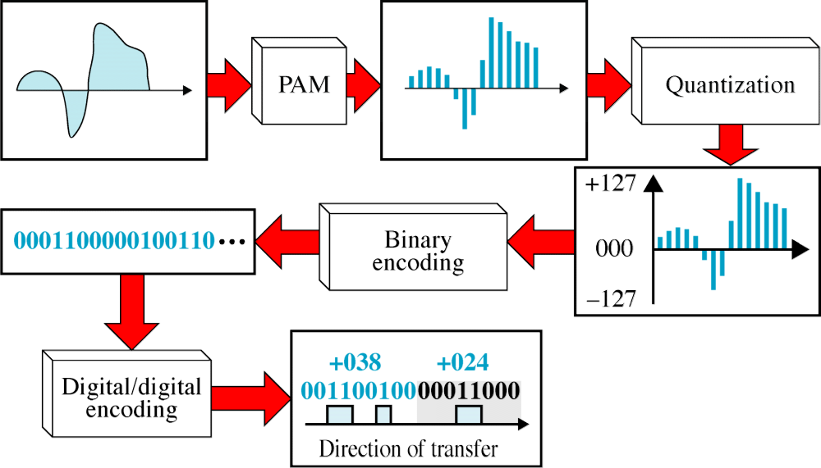
Figure 5-20-continued
From Analog to PCM
WCB/McGraw-Hill
© The McGraw-Hill Companies, Inc., 1998

Slide 41
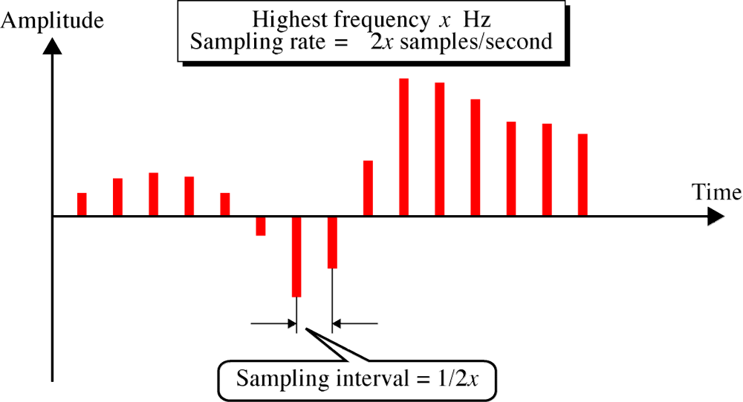
Figure 5-21
Nyquist Theorem
WCB/McGraw-Hill
© The McGraw-Hill Companies, Inc., 1998

